Slide 1
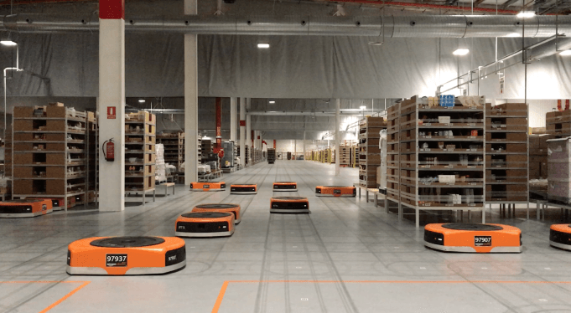
Amazon Robotics machines in a Amazon warehouse
Collision avoidance and coordination for a fleet of robots
Luca Marseglia

Slide 2
Summary
Considerations for more than 2 robots
Issues with the Fmincon approach
Genetic Algorithm
Energy consumption: Multi-objective optimization
Comparison with the previous approaches (VO combinations and Prioritzed planning)
2024 August | Slide 2

Slide 3
Considerations for more than 2 robots
The constraint on the safety margin does not refer to the distance between all the pairs of robots, but to the minimum distance between all the pairs
The slow-down segment is only applied on the first segment, so that the collisions can be solved at once in an optimal way. This is different from the concept of the Prioritized planning, that modifies the overall maximum velocities
2024 August | Slide 3

Slide 4
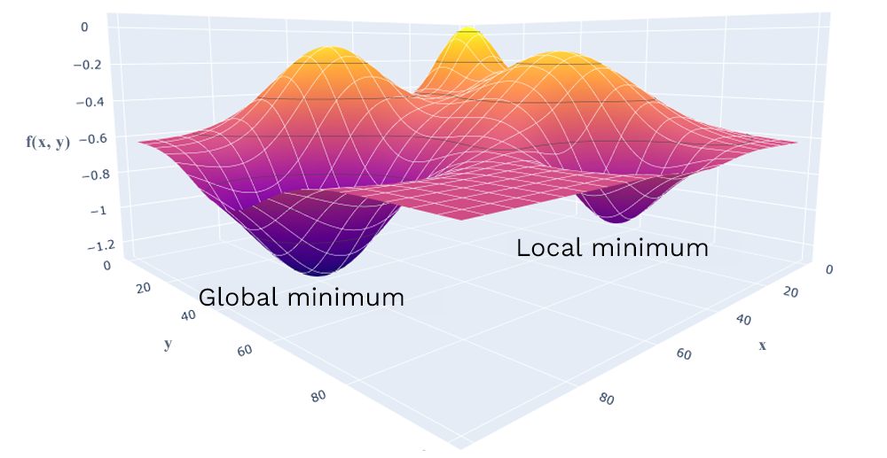
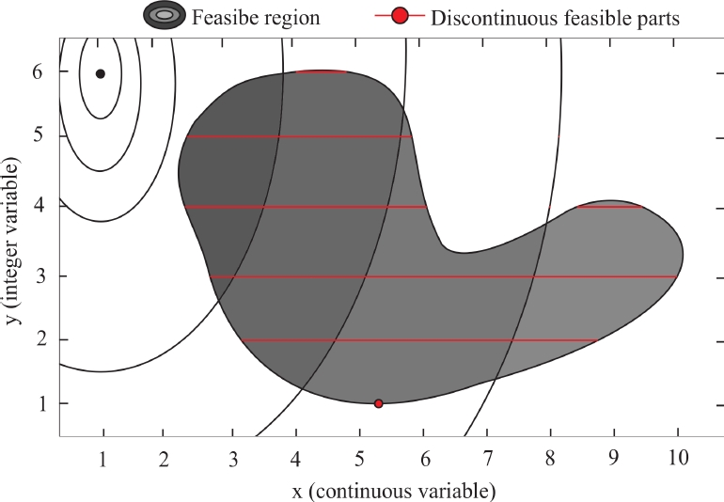
Fmincon issues
Local optimization
Non-mixed optimization
2024 August | Slide 4

Slide 5
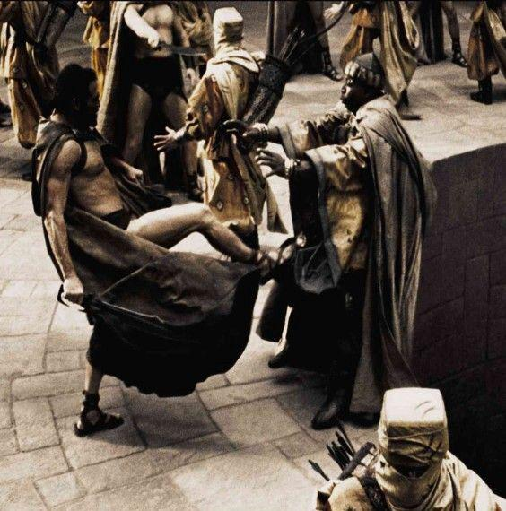
Genetic Algorithm
2024 August | Slide 5

Slide 6
Genetic Algorithm
Global optimization
Mixed-integer Nonlinear optimization
2024 August | Slide 6

Slide 7
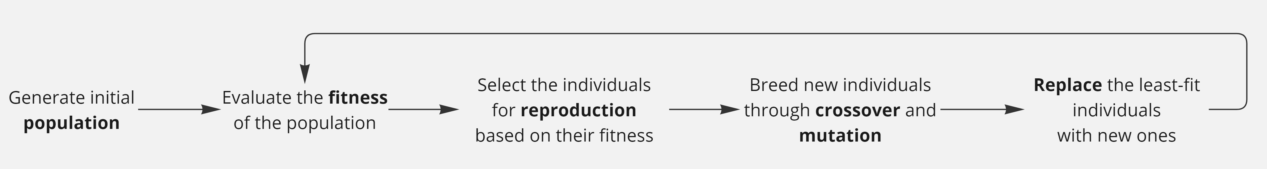
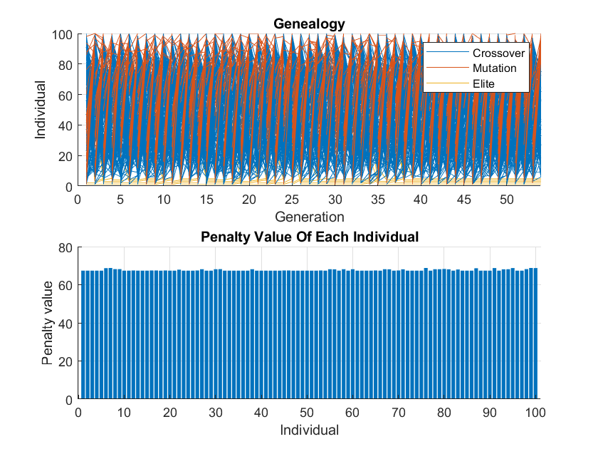
Genetic Algorithm
Crossover: combine two solutions (genetic material) of two parents to produce a new offspring.
Mutation: introduce diversity by randomly altering the solutions
No crossover = no evolution
No mutation = no exploration
2024 August | Slide 7

Slide 8

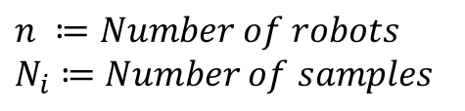
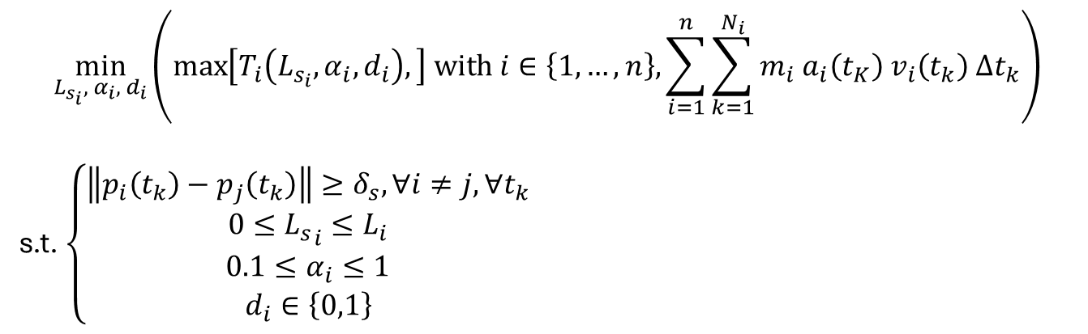
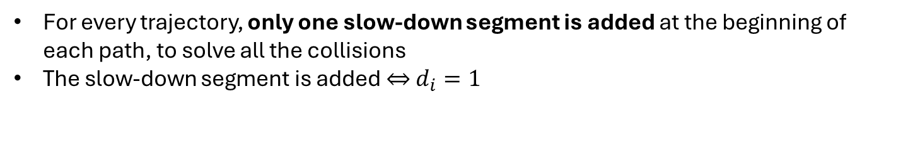
Problem setting
$$\min_{L_{s_{i}}, α_{i}, d_{i}}\left(\max\left[T_{i}\left(L_{s_{i}},α_{i},d_{i}\right),\right] with i∈\left\{1,…,n\right\}, \sum_{i=1}^{n}{\sum_{k=1}^{N_{i}}{m_{i} a_{i}\left(t_{K}\right) v_{i}\left(t_{k}\right) Δt_{k}}}\right)$$
s.t. $\left\{\begin{aligned}\left\|p_{i}\left(t_{k}\right)−p_{j}\left(t_{k}\right)\right\|≥δ_{s}, ∀i≠j,∀t_{k} \\ 0≤{L_{s}}_{i}≤L_{i} \\ 0.1≤α_{i}≤1 \\ d_{i}∈\left\{0,1\right\}\end{aligned}\right.$
$$n ≔Number of robots$$
$$N_{i}≔Number of samples$$
For every trajectory, only one slow-down segment is added at the beginning of each path, to solve all the collisions
The slow-down segment is added $⇔$ $d_{i}=1$
$$\left[d_{1},α_{1},{L_{s}}_{1},d_{2},α_{2},{L_{s}}_{2},…,d_{N},α_{N},L_{s_{N}}\right]$$
2024 August | Slide 8

Slide 9
Results and parameters tuning
2024 August | Slide 9

Slide 10
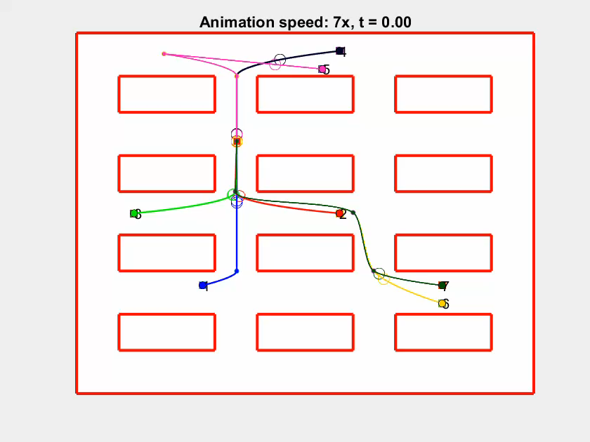
Before optimization – Finish time: 64.9 s
2024 August | Slide 10

Slide 11
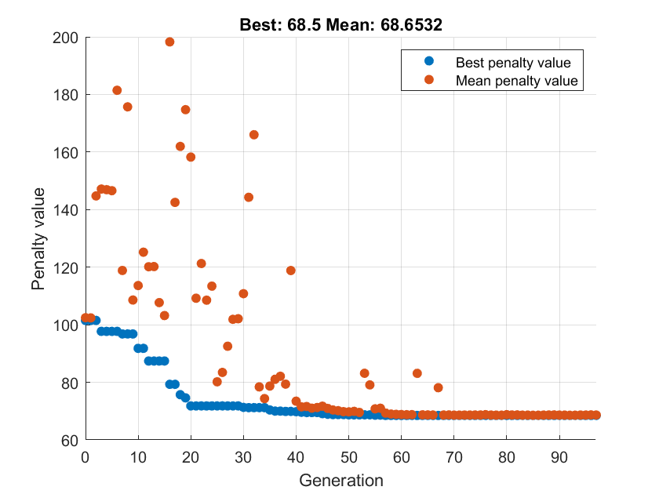
Optimization – MR: 50% / CF: 80% / P: 50
2024 August | Slide 11

Slide 12
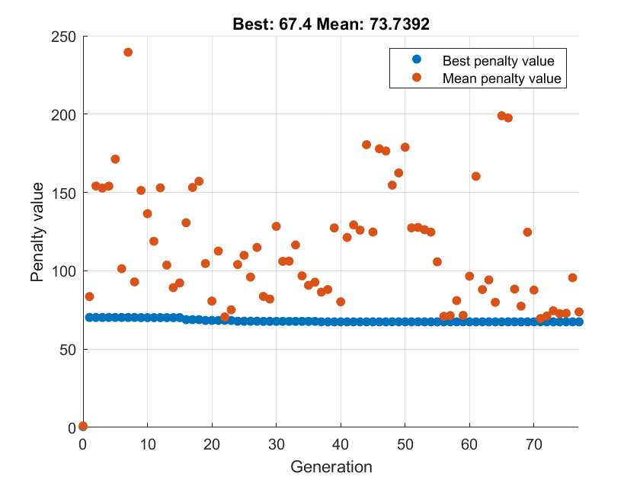
Optimization – MR: 50% / CF: 80% / P: 100
2024 August | Slide 12

Slide 13
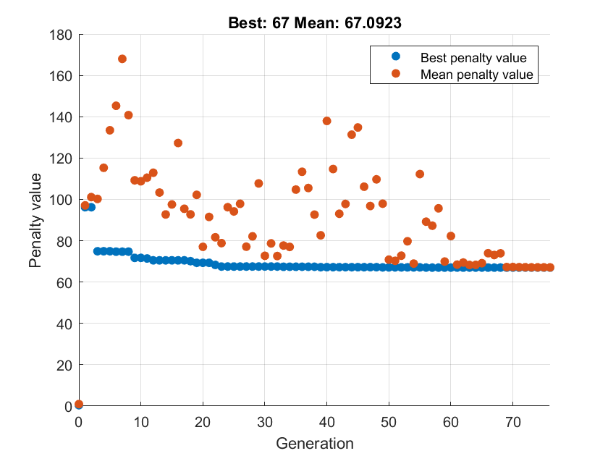
Optimization – MR: 75% / CF: 80% / P: 100
2024 August | Slide 13

Slide 14
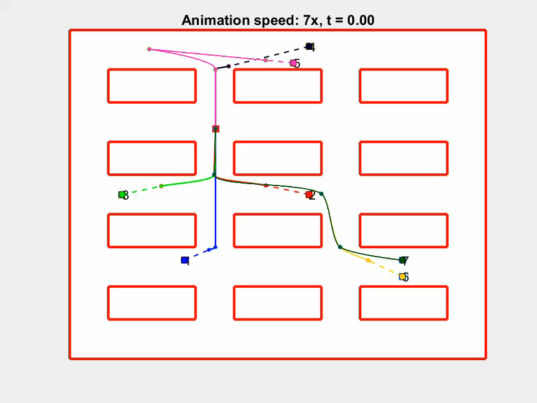

Optimization – MR: 75% / CF: 80% / P: 100
$$\left[d_{i},L_{s_{i}},α_{i}\right]= [1, 84.93, 0.27, 1, 140.84, 0.89, 1, 128.55, 0.47, 1, 264.57, 0.93, 1, 89.36, 0.89, 1, 120.67, 0.66, 0, 84.29, 0.71]$$
2024 August | Slide 14

Slide 15
Energy consumption optimization
2024 August | Slide 15

Slide 16
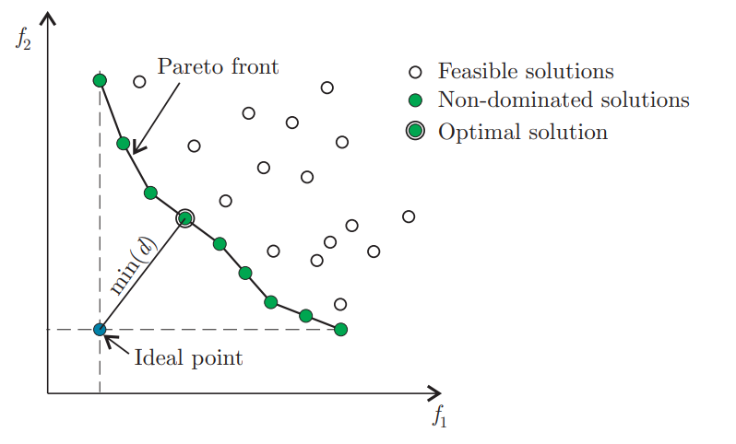
Energy optimization: Multi-objective Pareto problem
The two objective functions contradict each other:
a lower energy consumption implies a higher finish time
f1: Finish time
f2: Energy consumption
2024 August | Slide 16

Slide 17
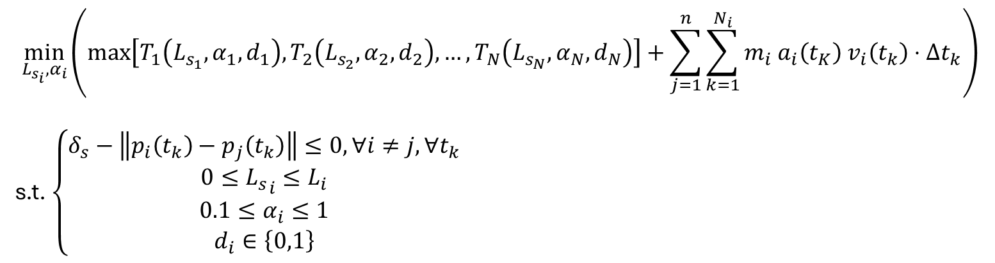
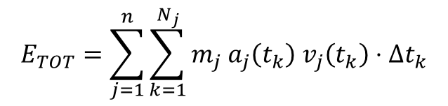
Problem setting
$$E_{TOT}=\sum_{j=1}^{n}{\sum_{k=1}^{N_{j}}{m_{j} a_{j}\left(t_{k}\right) v_{j}\left(t_{k}\right)⋅Δt_{k}}}$$
$$\min_{L_{s_{i}},α_{i}}\left(\max\left[T_{1}\left(L_{s_{1}},α_{1},d_{1}\right), T_{2}\left(L_{s_{2}},α_{2},d_{2}\right), …, T_{N}\left(L_{s_{N}},α_{N},d_{N}\right)\right]+\sum_{j=1}^{n}{\sum_{k=1}^{N_{i}}{m_{i} a_{i}\left(t_{K}\right) v_{i}\left(t_{k}\right)⋅Δt_{k}}}\right)$$
s.t. $\left\{\begin{aligned}δ_{s}−\left\|p_{i}\left(t_{k}\right)−p_{j}\left(t_{k}\right)\right\|≤0, ∀i≠j,∀t_{k} \\ 0≤{L_{s}}_{i}≤L_{i} \\ 0.1≤α_{i}≤1 \\ d_{i}∈\left\{0,1\right\}\end{aligned}\right.$
2024 August | Slide 17

Slide 18
Results – Finish time: 67.9 s / Total energy: 85 kJ
All the robots are supposed to have a mass of 1000 kg.
Selected solution
Different criteria can be used to select the best solution among those on the Pareto front:
Lowest finish time
Lowest energy consumption
Pareto-optimal solution
2024 August | Slide 18

Slide 19
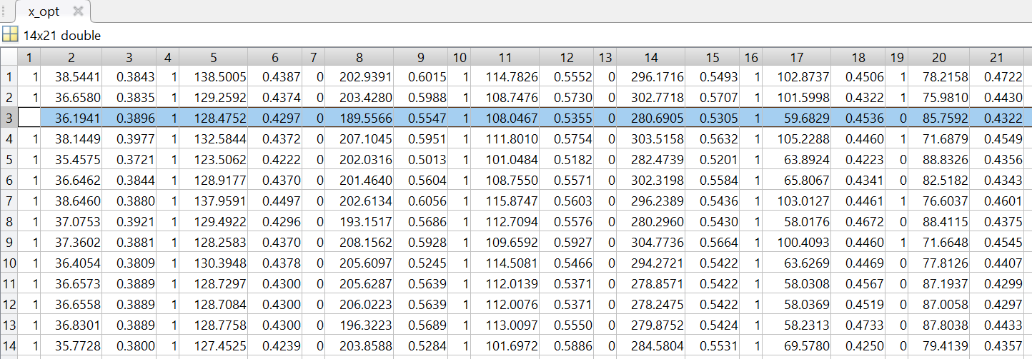
Results – Finish time: 67.9 s / Total energy: 85 kJ
2024 August | Slide 19

Slide 20
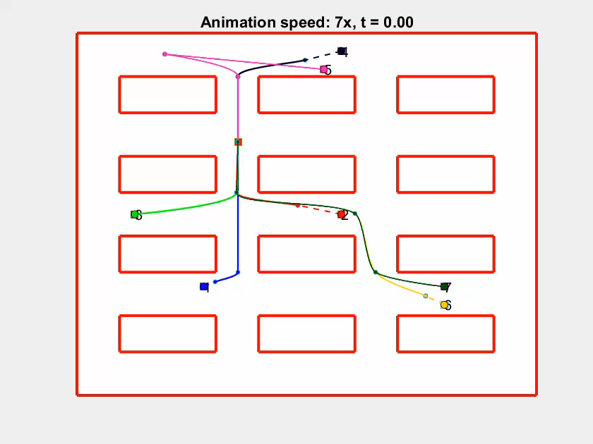
Results – Finish time: 67.9 s / Total energy: 85 kJ
2024 August | Slide 20

Slide 21
Comparison with the previous approaches
2024 August | Slide 21

Slide 22
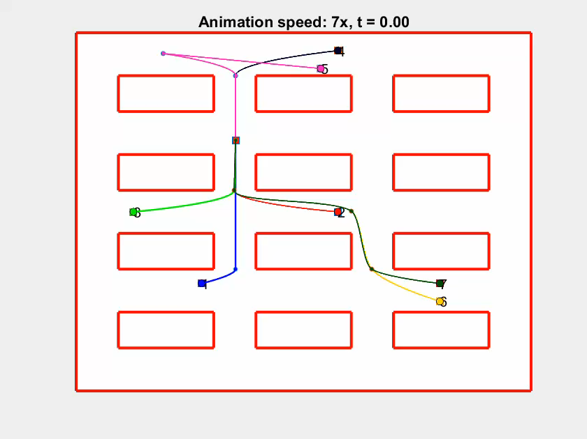

Comparison with Velocity Obstacles Combination
Max velocities = $[18, 16, 20, 14, 20, 18, 20]$
2024 August | Slide 22

Slide 23
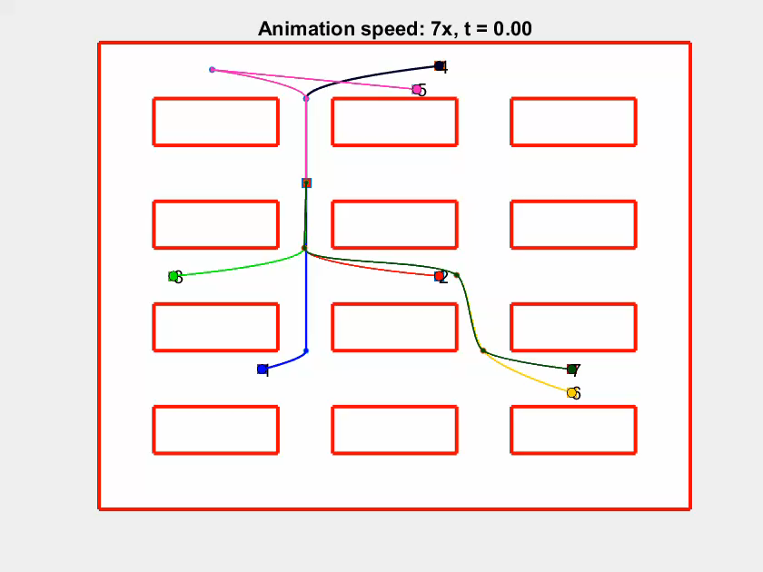

Comparison with Prioritized Planning
Max velocities = $[20, 16.50, 13.75, 19.33, 19.74, 20, 16.26]$
2024 August | Slide 23

Slide 24
Comparison with the other approaches
7 robots – 20 m/s
 | Velocity Obstacles Combinations | Prioritized planning | Single-objective GA | Multi-objective GA
Result | 69.7 s | 75.8 s | 67.4 s | 67.9 s / 85 kJ
Execution time | 12m 6s | 9.93 s | 7m 22s (76 generations, 20 stall generations) | 8m 59 s (80 generations)
Notes | The execution time strongly depends on the resolution of the search space and the number of robots | The finish time can be heavily affected by the scenario of the trajectories, depending on the heuristics
2024 August | Slide 24

